Slide 1

Notes:
Welcome to the gig economy! We are full force into this new era of the global workforce and as it expands we need to be adjusting to better meet the demands of its providers and users.

Slide 2
Gustavo Herrera, 46
Notes:
This is Gustavo, a 46 year old New Yorker who drives for Uber and Lyft.
I’d like us to all put on our empathy caps for a minute and think about Gustavo. Gustavo is a 46 year old New Yorker who drives for Uber and Lyft. He has to support his entire family by working for these gig economy platforms.
Well, the question that we are asking is..

Slide 3
How might we improve the lives of gig workers so that they are financially healthy and more resilient to financial shocks?
Bill & Melinda Gates Foundation

Slide 4
Gig Marketplace
Notes:
Any ideas for mockups here?

Slide 5
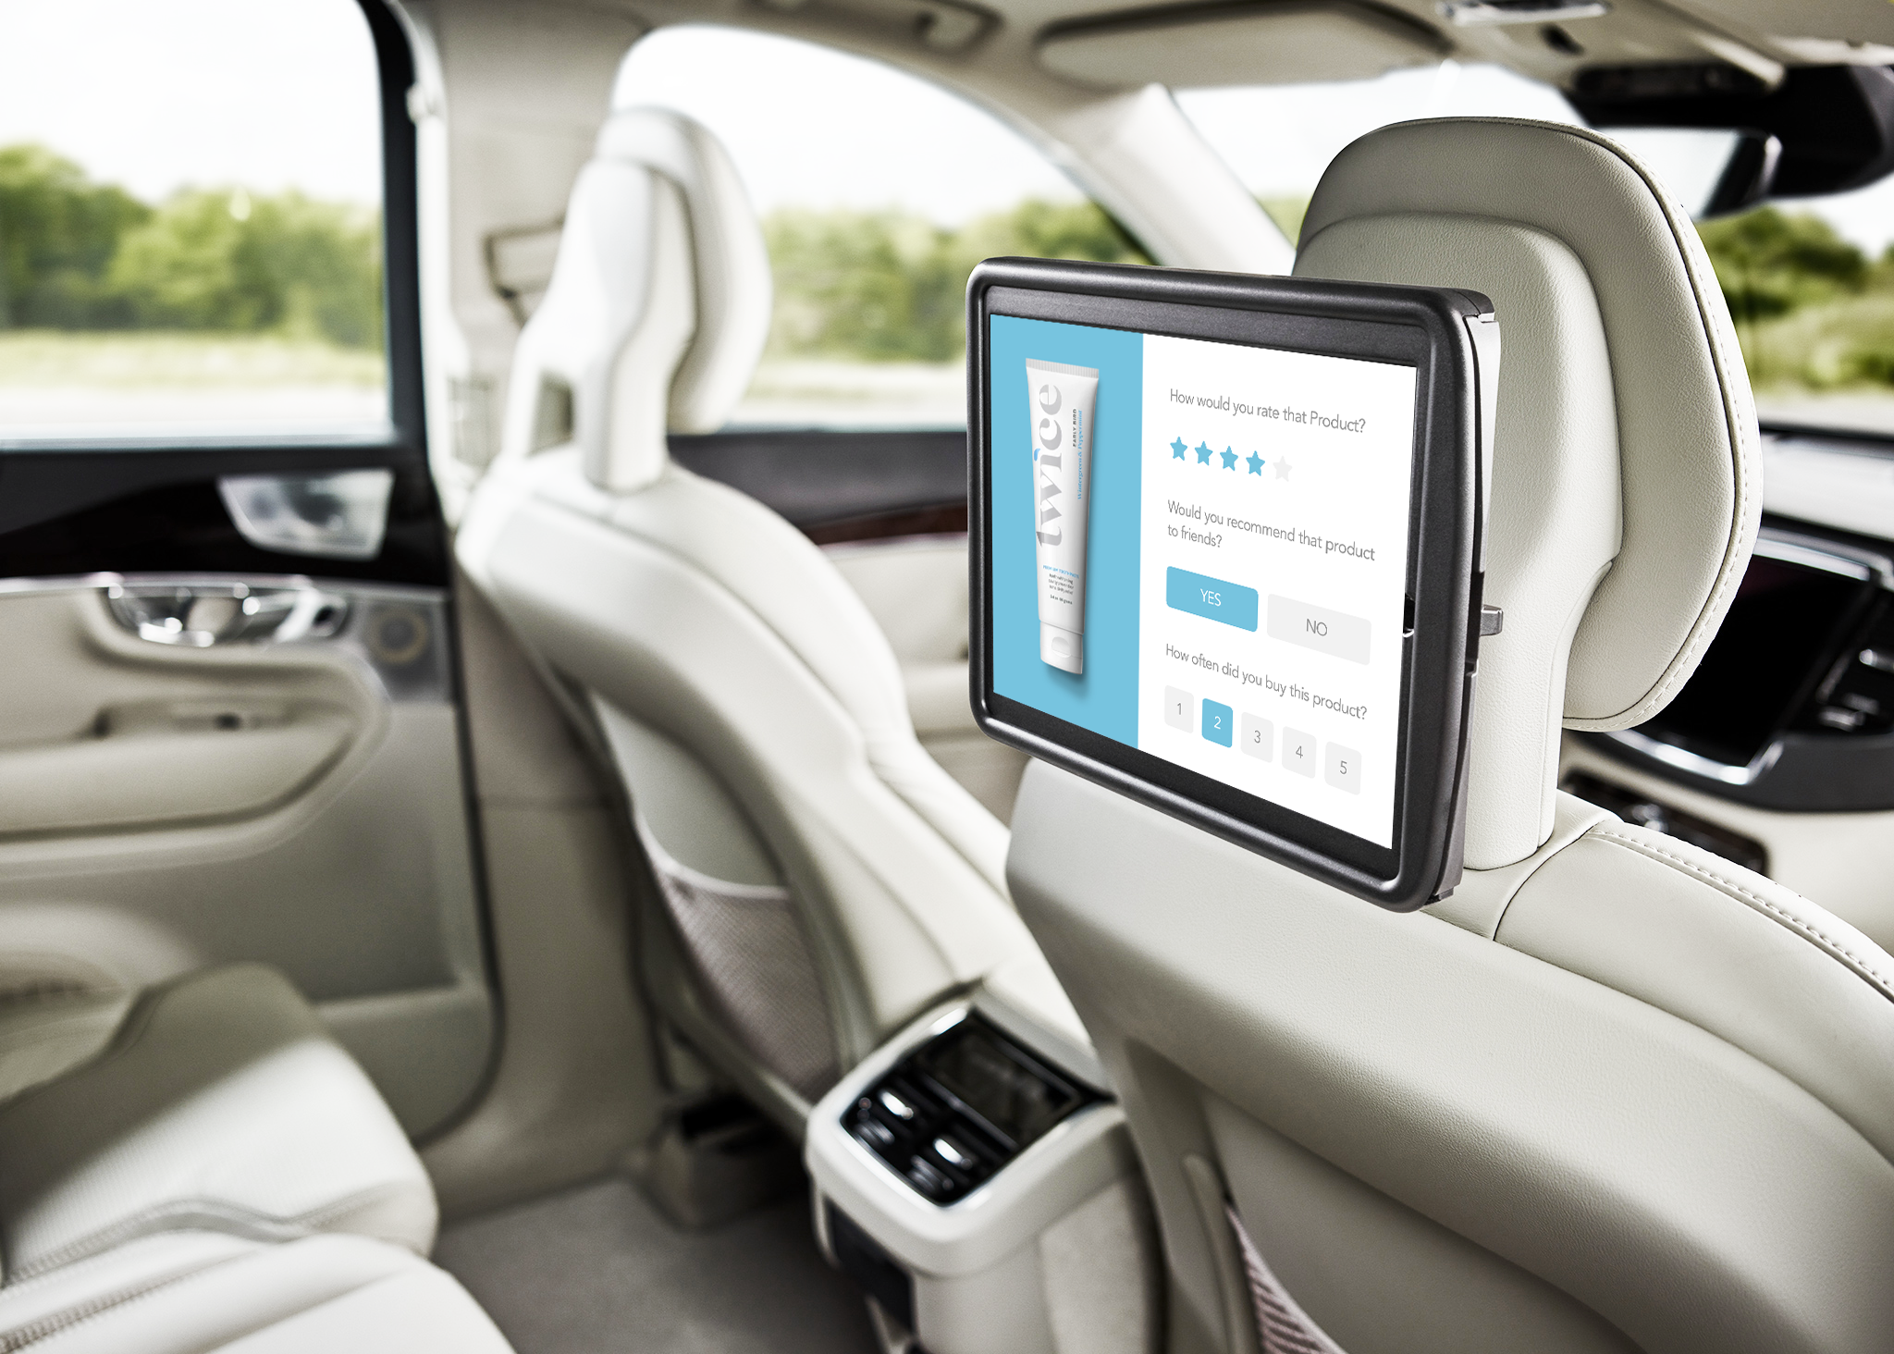
Data Aggregator

Slide 6

Insurflex

Slide 7
Gustavo Herrera, 46
Notes:
This is Gustavo, a 46 year old New Yorker who drives for Uber and Lyft.
I’d like us to all put on our empathy caps for a minute and think about Gustavo. Gustavo is a 46 year old New Yorker who drives for Uber and Lyft. He has to support his entire family by working for these gig economy platforms.
Well, the question that we are asking is..

Slide 8
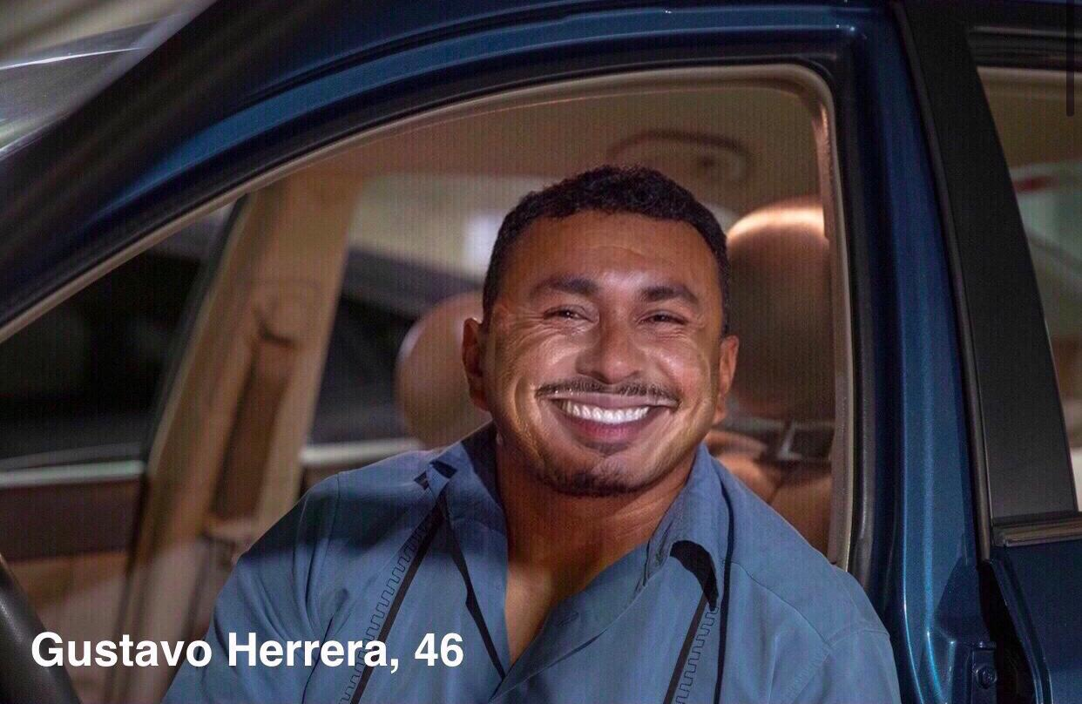
Gustavo Herrera, 46
Notes:
This is Gustavo, a 46 year old New Yorker who drives for Uber and Lyft.
I’d like us to all put on our empathy caps for a minute and think about Gustavo. Gustavo is a 46 year old New Yorker who drives for Uber and Lyft. He has to support his entire family by working for these gig economy platforms.
Well, the question that we are asking is..

